Slide 1
Section 2.5
Two Quantitative Variables: Scatterplot and Correlation
This slide deck contains animations. Please disable animations if they cause issues with your device.

Slide 2
Outline
Two quantitative variables
Visualization: scatterplot
Summary statistic: correlation

Slide 3
Direction of Association
A positive association means that values of one variable tend to be higher when values of the other variable are higher
A negative association means that values of one variable tend to be lower when values of the other variable are higher
Two variables are not associated if knowing the value of one variable does not give you any information about the value of the other variable

Slide 4
Cars Data (Variables and Relationships)
Quantitative Variables:
Weight (pounds)
City MPG
Fuel capacity (gallons)
Page number (in Consumer Reports)
Time to go ¼ mile (in seconds)
Acceleration time from 0 to 60 mph
Relationships
Weight vs. CityMPG
Weight vs. FuelCapacity
PageNum vs. Fuel Capacity
Weight vs. QtrMile
Acc060 vs. QtrMile
CityMPG vs. QtrMile

Slide 5


Cars Data (Strength and Direction)
Make initial guesses for the strength and direction of association for each of the following:
Weight vs. CityMPG
Weight vs. FuelCapacity
PageNum vs. Fuel Capacity
Weight vs. QtrMile
Acc060 vs. QtrMile
CityMPG vs. QtrMile

Slide 6
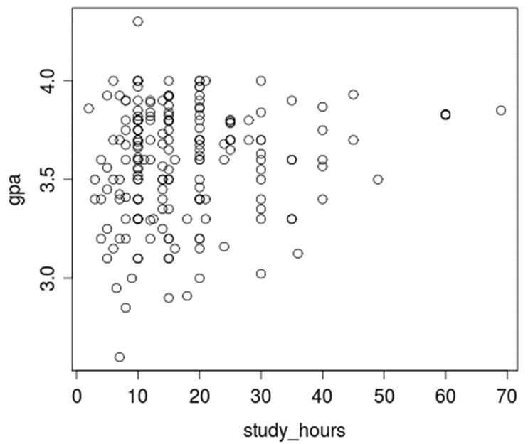
Scatterplot
A scatterplot is the graph of the relationship between two quantitative variables.

Slide 7
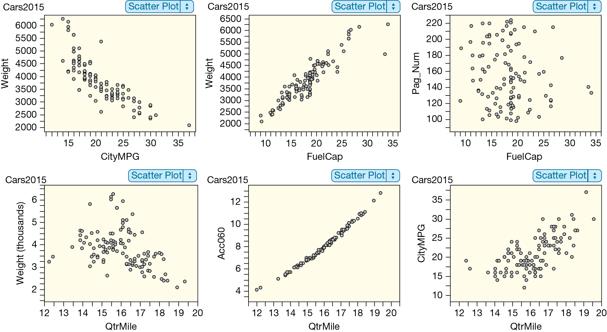
Car Associations

Slide 8
Correlation (Definition)
The correlation is a measure of the strength and direction of linear association between two quantitative variables
Sample correlation: r
Population correlation: ρ (“rho”)

Slide 9
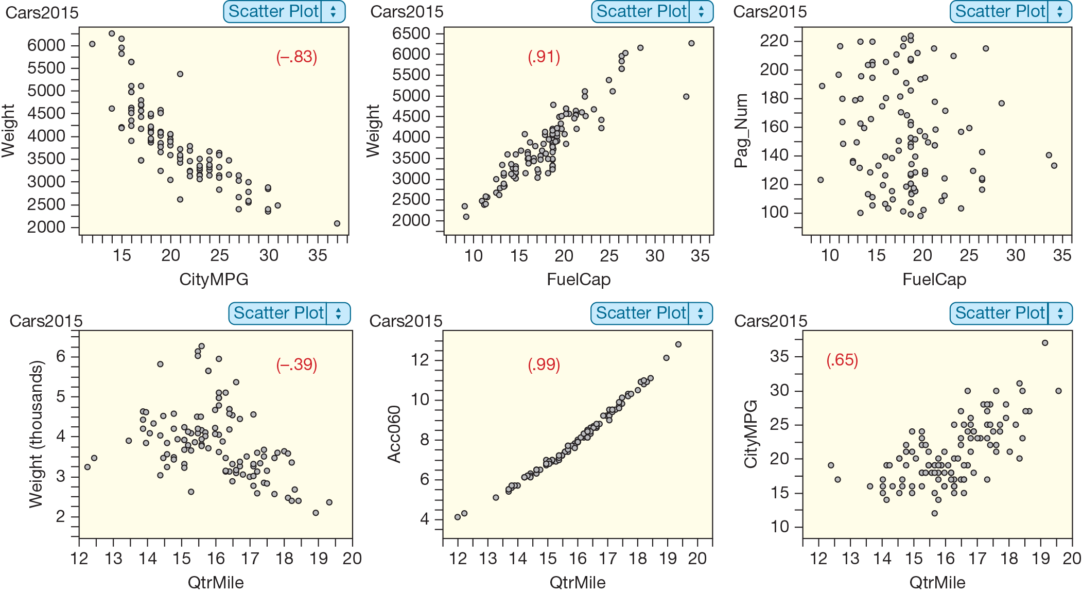
Car Correlations
What are the properties of correlation?

Slide 10
Correlation (What Does It Tell Us?)
−1 ≤ r ≤ 1
The sign indicates the direction of association
positive association: r > 0
negative association: r < 0
no linear association: r ≈ 0
The closer r is to ±1, the stronger the linear association
r has no units and does not depend on the units of measurement
The correlation between X and Y is the same as the correlation between Y and X

Slide 11
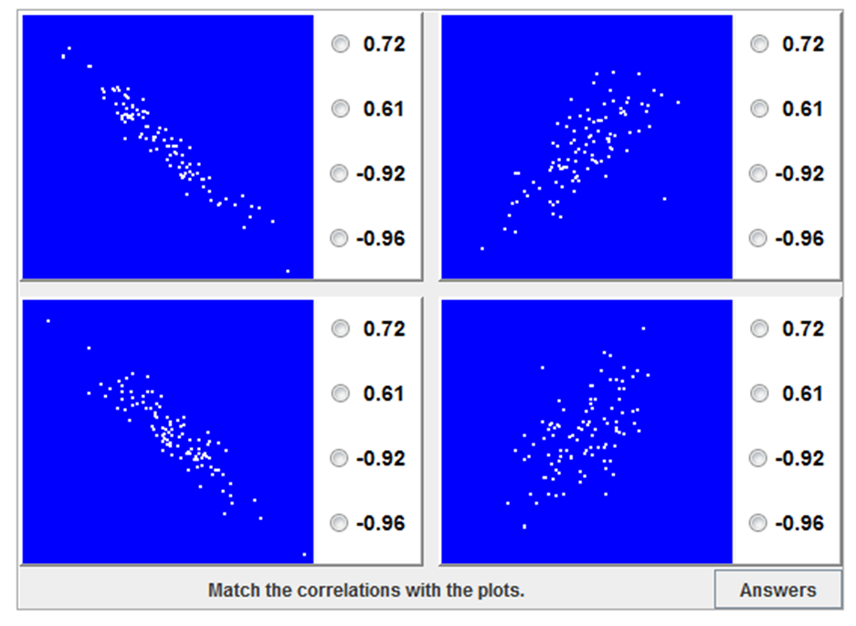
Correlation Guessing Game
http://istics.net/stat/correlations/
Highest scorer in the class gets an extra point on the first exam!

Slide 12
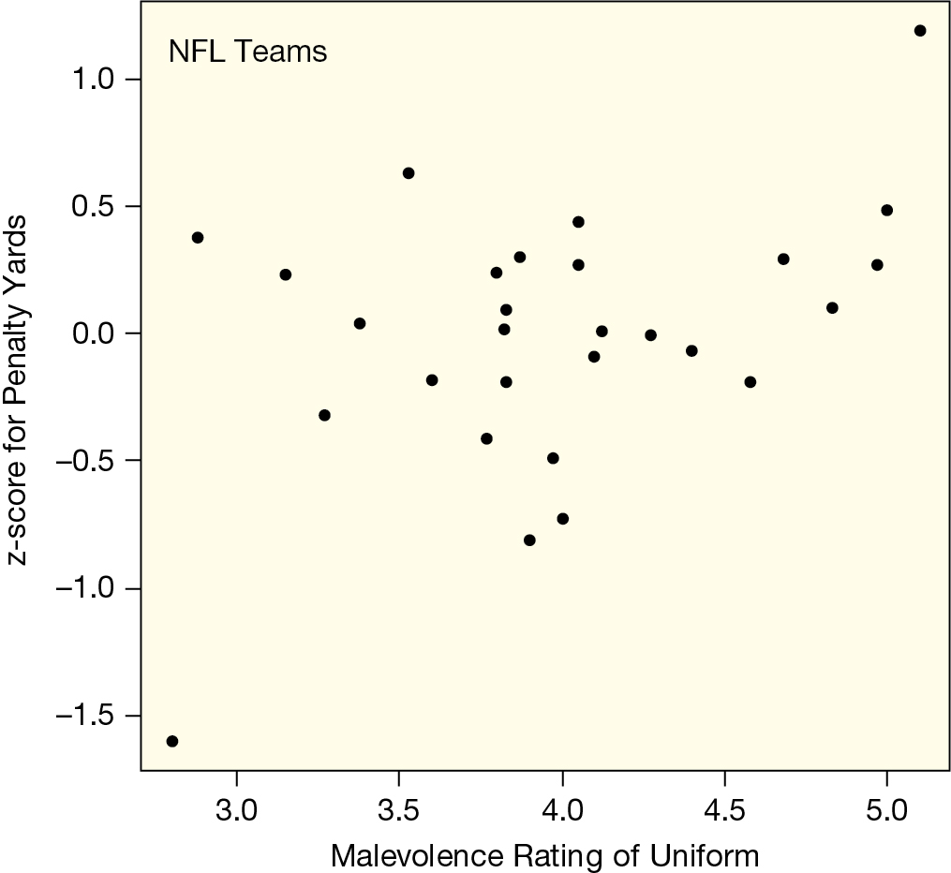
Correlation (NFL Teams)

Slide 13
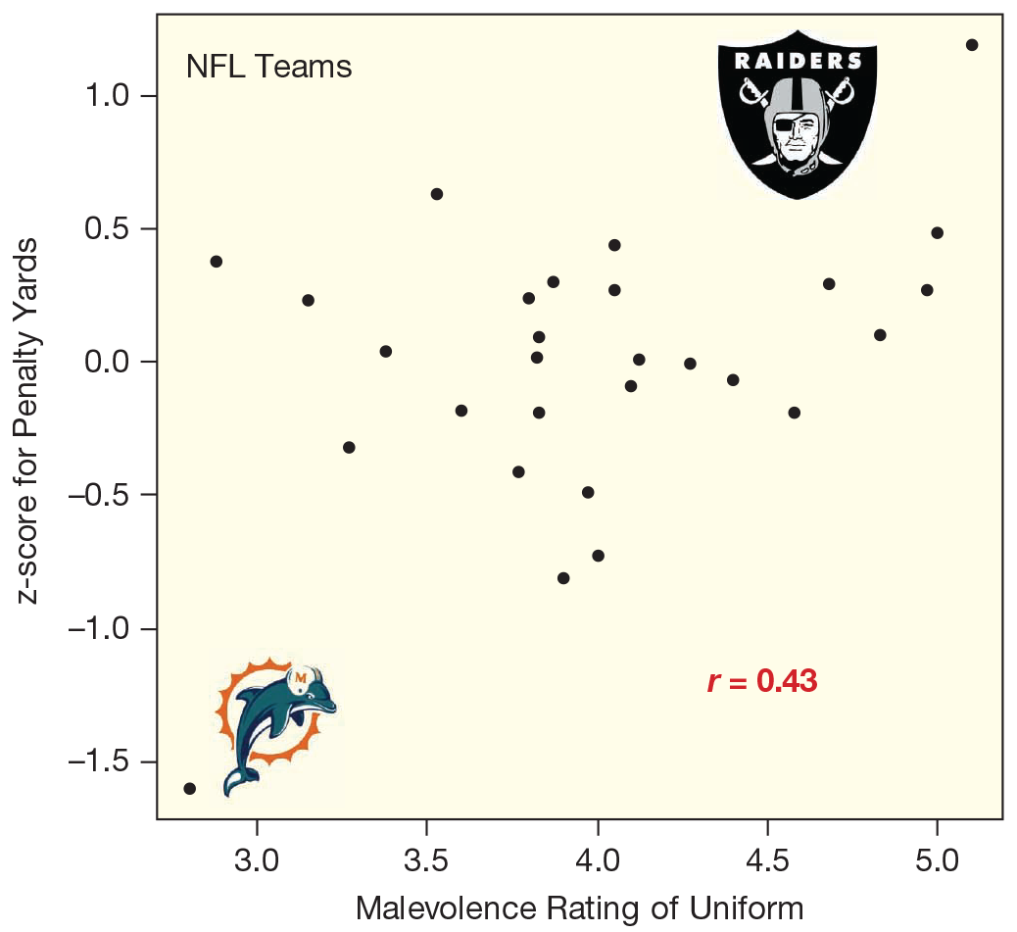
Correlation (Who are the Outliers?)

Slide 14
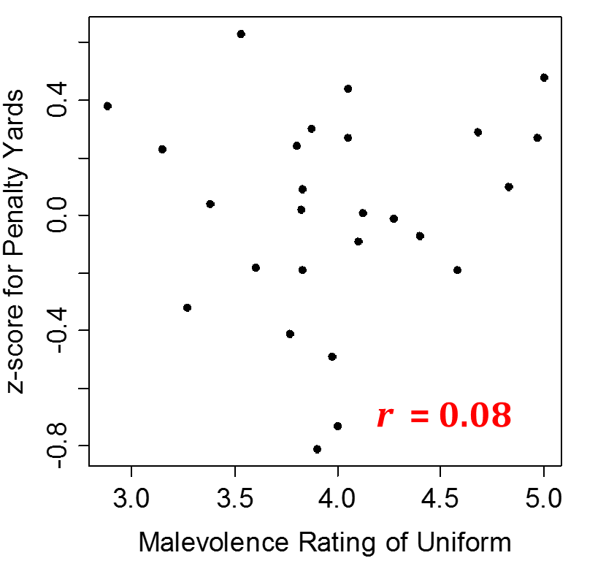
Correlation (Outliers Removed)
Same plot, but with Dolphins and Raiders (outliers) removed

Slide 15

Correlation Cautions (Outliers)
Correlation can be heavily affected by outliers. Always plot your data!

Slide 16
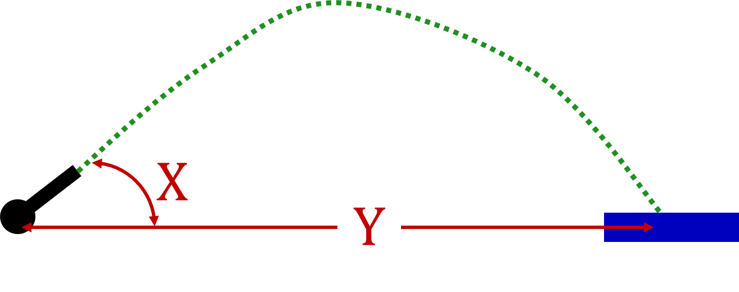
Human Cannonball
Plot Y vs. X
What is the correlation between X and Y?
r ≈ 0
Are X and Y associated?
Yes!
Notes:
Plotting y versus x should look like a sine curve… y = 0 when x = 0, y is maximized when x = 45, y = 0 when x = 90, y is negative when x is between 90 and 180, y = 0 when x = 180, … (draw this on the board)
positive and negative associations cancel out, so r = 0

Slide 17
Correlation Cautions (r = 0)
Correlation can be heavily affected by outliers. Always plot your data!
r = 0 means no linear association. The variables could still be otherwise associated. Always plot your data!

Slide 18
TVs and Life Expectancy

Slide 19
Correlation Cautions (and Causation)
Correlation can be heavily affected by outliers. Always plot your data!
r = 0 means no linear association. The variables could still be otherwise associated. Always plot your data!
Correlation does not imply causation!

